Slide 1
CSC141 - Introduction to Computer Programming Credit Hours 4(3,1)
Teacher:
AHMED MUMTAZ MUSTEHSAN

Slide 2
Additional References:
1. Reference book:
“Programming Languages and Methodologies”
by Robert J. Schalkoff Publisher Jones and Barrlett
2. http://en.wikipedia.org/wiki/Flash_memory
3. www.slipperybrick.com

Slide 3
Types of Memory
Memory
RAM
Volatile Memory
ROM
Non-Volatile Memory
Loses its contents when power goes off
Doesn’t lose its contents when power goes off

Slide 4
Types of RAM
RAM
Dynamic RAM (DRAM)
Used in Main Memory
Slower
Data needs to be refreshed periodically
Consumes more Power
Less Desirable
Cheap
Static RAM (SRAM)
Used in Cache Memory
Faster
Data DOES NOT need to be refreshed.
Consumes Less Power
More Desirable
Expensive

Slide 5
Types of Memory Modules
Memory Modules
SIMM
(Single Inline Memory Module)
72-pins
Transfers information over a 32-bit data path
DIMM
(Dual Inline Memory Module)
168 and 184-pins
Transfers information over a 64-bit data path
RIMM
(Robust ® Inline Memory Module)
184-pins
Transfers information over a 16-bit data path

Slide 6
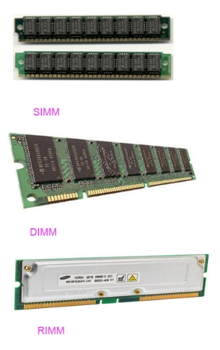
SIMM, DIMM and RIMM
Source:
Webanswers.com

Slide 7
Cache Memory
The cache is a small amount of high-speed memory, usually with a memory cycle time comparable to the time required by the CPU to fetch one instruction.
The most frequently used instructions are kept in cache memory so that CPU can look there first. Saved time which was wasted by CPU in swapping instructions in and out of main memory.
It can be located on Microprocessor chip or on a separate chip next to CPU.

Slide 8
Levels of Cache Memory
L1 (Primary or Internal Cache):
Located directly on the processor chip
Runs at the same speed as the CPU
Small Capacity
L2 (Secondary or External Cache):
Located directly on the processor chip
Runs at CPU speeds (or nearly so)
Larger capacity than L1 but slower than L1.
L3:
Part of the system’s motherboard.
Present in high-performance systems like servers.
Larger capacity than L2 but slower than L2.

Slide 9
Types of ROM
ROM (Read-Only Memory)
PROM (Programmable Read-Only Memory)
EPROM (Erasable Programmable Read-Only Memory)
EEPROM (Electrically Erasable PROM)
Flash EEPROM

Slide 10
ROM (Read-Only Memory)
Also known as Firmware
Manufactured with permanently written data.
Cannot be erased or written on by the user.
PROM (Programmable Read-Only Memory)
one-time programmable non-volatile memory
manufactured blank
depending on the technology, PROM can be programmed at final test.
EPROM (Erasable Programmable Read-Only Memory)
Multiple times erasable programmable non-volatile memory
It requires UV box to erase the EPROM

Slide 11
EEPROM (Electrically Erasable PROM)
user-modifiable read-only memory (ROM)
can be erased and reprogrammed (written to) repeatedly through the application of higher than normal electrical voltage generated externally or internally
For Example: Flash Memory.

Slide 12
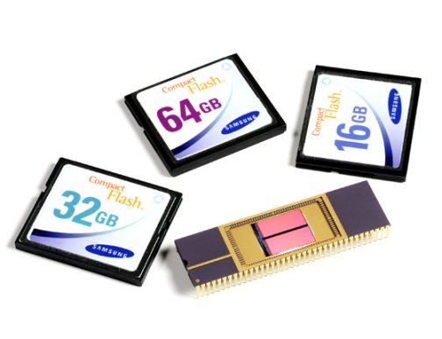
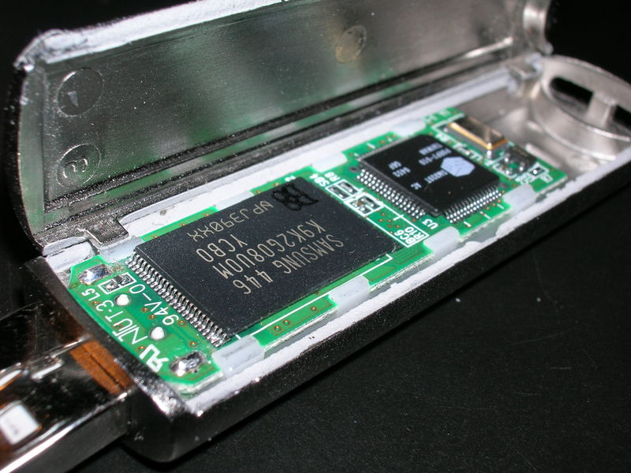
Flash Memory
Non-volatile Electrically Erasable Programmable Read-Only Memory
Examples: memory cards, USB flash drives, solid-state drives
Source: http://en.wikipedia.org/wiki/Flash_memory
www.slipperybrick.com

Slide 13
CMOS Memory (BIOS Memory)
Small memory on PC motherboards that is used to store BIOS settings.
Traditionally called as CMOS RAM
It uses a low-power Complementary metal-oxide-semiconductor (CMOS) SRAM which is powered by a small battery to retain information when power goes off.
Stores configuration information about the computer
Disk drives
Keyboard
Mouse‘
Monitor
Time/date.

Slide 14
Processing
Input
Processing
Output
Input device
Central Processing Unit
Main Memory
Output Devices
Bus

Slide 15
Data flow for a complete job
Input device
Central Processing Unit
Main Memory
Output Devices
Input device
Central Processing Unit
Main Memory
Output Devices
(a) First data flows from the input device into the main memory
(b) Next CPU brings the data into its registers for processing
Input device
Central Processing Unit
Main Memory
Output Devices
Input device
Central Processing Unit
Main Memory
Output Devices
(c) Then CPU sends processed data back to main memory
(d)Finally the results go to the output device
Steps (b) and (c ) usually repeat many times

Slide 16
Programming Language

Slide 17
Programming Language:
A programming Language is a notational system intended primarily to facilitate human-machine interaction.
The notational is understood both by human and machine.
The programming language has Syntax, and language elements have Semantics.

Slide 18
What is a program?
A program is something that is produced using a programming Language.
A program is a structured entity with Semantics.

Slide 19
What is programming?

Slide 20
What is programming?
Programming is a Science:
Because it implement the algorithms describe by mathematics and science.
Programming is a Skill:
Because it requires design efforts.
Programming is an Engineering:
Because it requires a tradeoffs between program size, speed, time (required for development and debugging) and maintainability among many solutions.
Programming is an Art
It requires creativity and employ imagination.

Slide 21
Types of programming Languages

Slide 22
Levels/Generations of Programming Languages
CSC141 Introduction to Computer Programming
1st Generation Programming language (1GL)
Machine Language: 0s or 1s
2nd Generation Programming language (2GL)
Assembly Language : Mnemonics
3rd Generation Programming language (3GL)
High-Level Languages ; (procedure oriented or Object Oriented)
4th Generation Programming language (4GL)
Very-High-Level Languages
5th Generation Programming Language
Natural Languages

Slide 23
Machine language (1GL)
The lowest level of language.
The language used to program the first-generation computers.
The instructions in 1GL are made of binary numbers, represented by 1s and 0s.
1s and 0s correspond to the on and off states of electrical switches.
Suitable for the understanding of the machine but very much difficult to interpret and learn by the human programmer.

Slide 24
Assembly language (2GL)
Low-level language that allows a programmer to use abbreviations or easily remembered words instead of numbers.
These Observations are called Mnemonics. These Mnemonic are Opcode and Operands
For Example: ADD AX, BX
MOV CX, AX
INC CX
Op-code; ADD, MOV, INC
Operands AX, BX,CX

Slide 25
Assembly language (2GL)
Programmer can write instructions faster but it is still not an easy language to learn.
Drawback: The language is specific to a particular processor family and environment. (Machine Dependent Language)
Assembler – A program that translates the assembly language program into machine language.

Slide 26
High Level languages (3GL)
A High-Level Language is an English-like language.
It is a refinement of a second-generation programming language.
It allowed users to write in familiar notation, rather than numbers or abbreviations.
Most High-level languages are not Machine Dependent.
Translator for High-level languages is either a Compiler or an Interpreter.
Examples of High-level languages:
FORTRON
COBOL
BASIC
C and C++

Slide 27
Very-High-Level Languages (4GL)
4GLs are much more user-oriented and allow programmers to develop programs with fewer commands compared with 3GLs.
Non-Procedural Language; Programmers don’t have to specify all the programming logic, only tell the computer what they want done.
Saves a lot of time.
4GLs consist of report generators, query languages, application generators, and interactive database management system
For example:
RPG III (Report Generator)
SQL (Structured Query Language)
NOMAD and FOCUS (DBMS)

Slide 28
Natural Languages (5GL)
Two types
Ordinary Human Languages; like English.
Programming language that use human language to give people a more natural connection with computers.
5GLs are designed to make the computer solve a given problem without the programmer.
Natural languages are part of the field of study known as Artificial Intelligence.
Develop machines to emulate human-like qualities such as learning, reasoning, communicating, seeing and hearing.

Slide 29
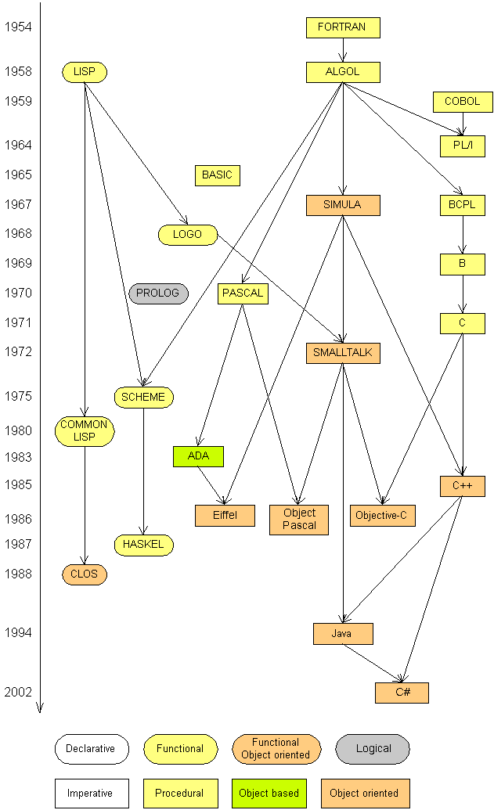
Evolution of Programming

Slide 30
Programming Paradigms
A number of programming paradigms are:
Procedural/Imperative Programming
Functional Programming
Declarative Programming
Object Oriented Programming
Event driven Programming
Parallel Programming

Slide 31
Procedural or Imperative:
Imperative programs emphasize “tell what to do”
When we say “ Do this, then do this, then do this, and if xx, do this, otherwise do this” This is imperative programming:
They focus on evaluating expressions and storing results in a variable.
The most common imperative language consists of statements such as:
a = 10;
b = 5;
c = a + b;

Slide 32
Procedural or Imperative: … Contd
Example of imperative languages are:
Assembly language
COBOL
Pascal
C and C++

Slide 33
Is there any Best Programming Language?
Programming Language is probably used most efficient if it is well suited For a specific task.
For example
Business applications are often written in COBOL.
Beginners to programming use BASIC.
Scientific programming is often undertaken with either FORTON, PASCAL or C.

Slide 34
Language Evaluation Criteria
Readability: measure programmer ease in reading source code
Orthogonality: include context sensitive restrictions.
Applicability: this is best suited as “use the right tool for the job”
Writ ability: includes simplicity and orthogonality and support for the abstraction
Reliability: include type checking and inspection handling
Cost: includes learning and writing cost, productivity, compilation cost, execution cost, debugging cost etc.
Other: flexibility of control statements and availability of data structures

Slide 35
History of C Language
A general-purpose computer programming language.
Developed between 1969 and 1973 by Dennis Ritchie at the Bell Telephone Laboratories for use with the UNIX operating system.
Descendant of Ken Thompson’s language “B”
The first C programming language standard was published in 1978 as “The C Programming Language” by Kernighan and Ritchie (K&R).
"ANSI C" was the second C programming language standard published in 1989.
ISO approved “ANSI C” in 1990.
The latest stable release is C11.

